Slide 1



ECT Induction Tutors
Breakfast Briefing
Thursday 4th September 2025
Dionne Heaven
cktsh@sharemat.co.uk

Slide 2
Welcome back!
We are looking forward to a very busy half term of working with you all.
New ECT and mentor registrations
Training events for ECTs and mentors
My ECT and Steplab access
Coaching and engagement requirements
Tutor training and resources
Appropriate Body update

Slide 3
New ECTs and Mentors for 2025
Two steps to add a new ECT:
Register your ECTs and mentors on the DfE portal: Manage training for early career teachers (education.gov.uk)
Register your ECTs on ECT Manager: Calderdale and Kirklees Teaching School Hub - ECT Paperless Induction and Assessment Management System (ectmanager.com)
We are working to identify any ECTs who are only registered on one website. We will contact individual schools to advise.

Slide 4
ECTP Mentor training (new Sept 2025)
Conference 1 (Year 1 mentors)
Wednesday 17th September - The Maltings, Halifax
Friday 19th September - Batley Girls’ High School
Tuesday 23rd September – Royds Hall High School, Huddersfield
Booking link will be shared on the follow up handout, as well as with mentors we are already aware of. Please share with all new mentors in your school.
Mentors have one year to complete their training. This comprises one face-to-face conference and two online events (covering conference 2 and a clinic).
Dates for online events will take place on a variety of dates in the Spring and Summer terms.

Slide 5
ECF Mentor training (legacy programme)
Conference 2 (Year 2 mentors)
Thursday 11th September - Whitcliffe Mount School, Cleckheaton
Please note : 9.00 – 12.30
Mentors before July ‘25 have a two-year window to complete their mentor training (attend Conference 1 and 2 and online Clinics). After this they are fully qualified and need not attend future training.
If you know you need to complete any of the individual modules, please contact the Hub and we can assign study materials.

Slide 6

MyECT and Steplab
New Ambition platform – login here to complete onboarding and access Steplab – Login
There are useful video guides in the Support section
Complete Steplab Access Form here
Log in to Steplab here
Support and resources here

Slide 7
ECT Coaching requirements
Year 2 ECTs – fortnightly coaching on Steplab and fortnightly reading
Non-September ‘25 Year 1 ECTs – weekly coaching on Steplab and weekly reading (behaviour; instruction; subject)
- All experienced mentors should know how to do this.
September ‘25 new starters
MUST have WEEKLY coaching (instructional recorded on Steplab, pastoral recorded on MyECT)
MUST have at least fortnightly instructional coaching.
Fortnightly reading – one module at a time. No requirement to start until attended Conference 1. ECTs can complete welcome module.

Slide 8
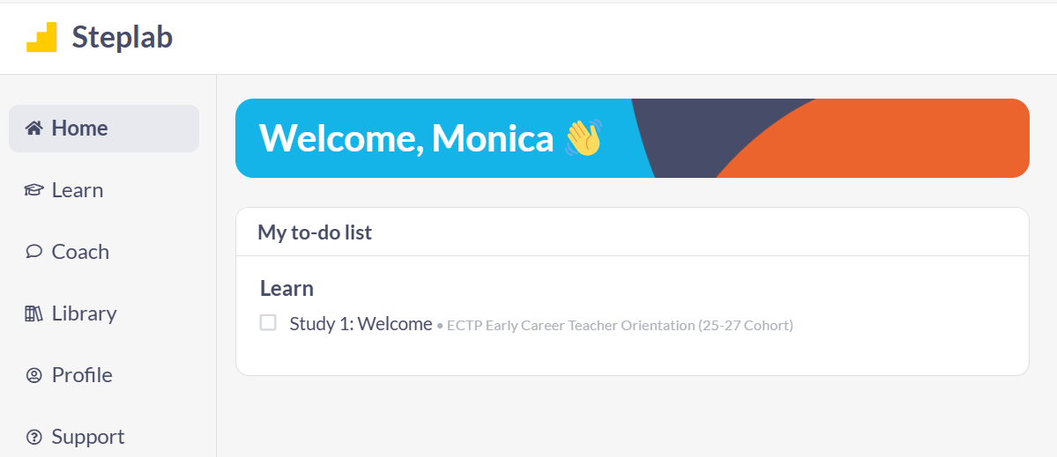
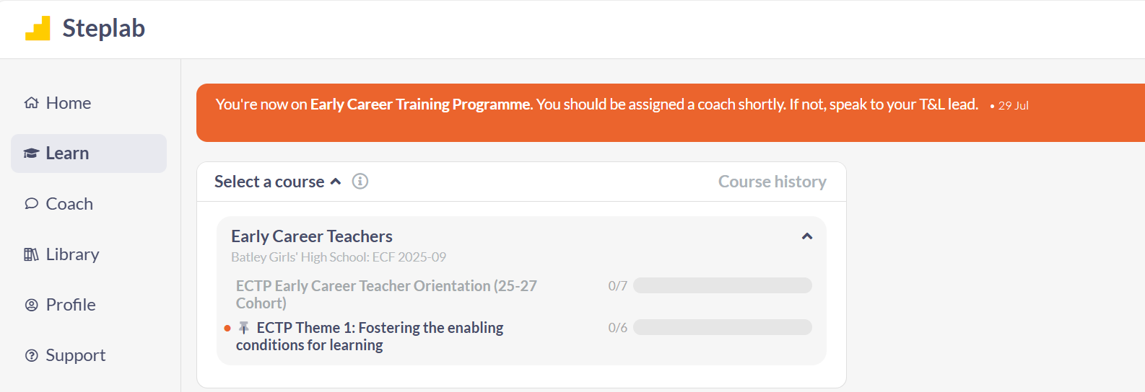
ECT Welcome module
ECTs can complete the Welcome module – Orientation.
No requirement to begin the Theme 1 reading until they have been to the Conference 1 event.
Please remind them – only one module each fortnight. They can re-read it if they wish to.

Slide 9
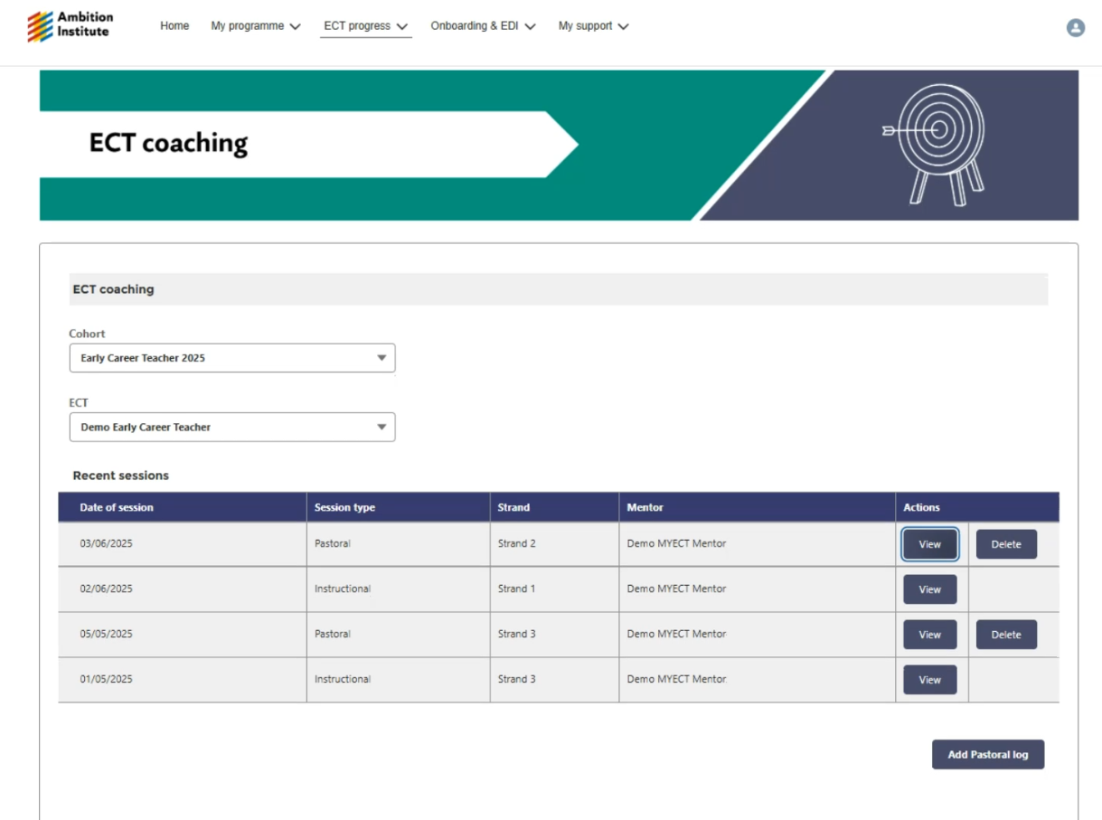
Record pastoral coaching here

Slide 10
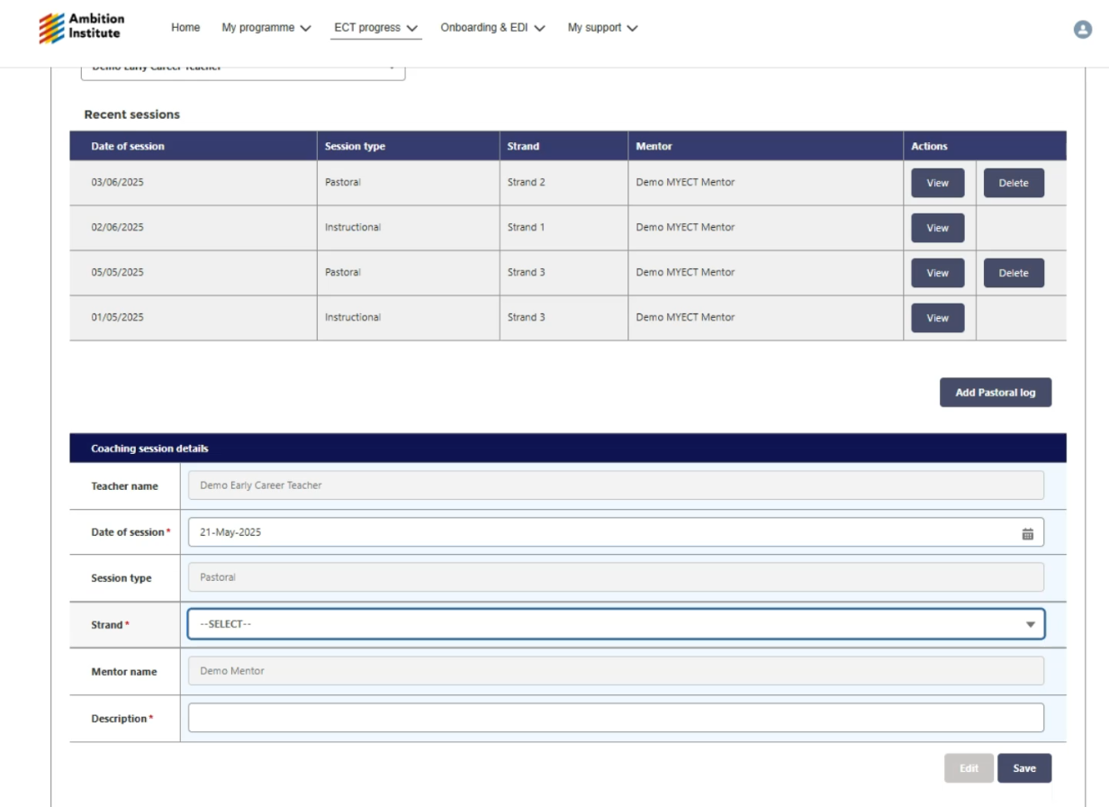
The mentor must complete a brief log of the pastoral coaching session, otherwise it will be classed as non-engagement.

Slide 11
ECT Conferences – booking arrangements
ECT will NOT be invited to a specific Conference – they will have a choice of venues and dates. They will need to book on to their choice of Conference (first come, first served basis).
Conference 3 dates, venues and booking links were sent out to ECTs yesterday (3rd Sept.)
Conference 1 booking opens Friday 6th September. A welcome email with booking links will be sent directly to ECTs.
ECTs on ‘out of sync’ journeys will be contacted individually as required.
We will Bcc Induction Tutors into correspondence with ECTs regarding event attendance so that you aware of chosen dates for cover purposes, etc.

Slide 12
Steplab access and onboarding
Please ensure all staff complete the onboarding process – Steplab Access Form on MyECT
Check your To Do list on Steplab to ensure your ECTs and mentors have been paired together correctly. If not, check DfE portal for matches.
Let us know if anyone has not received their onboarding email or cannot access My Ambition.
Email ectsupport@ambition.org.uk for general enquiries and resets.

Slide 13
Year 2 Steplab engagement
All modules released now – Behaviour; Instruction; Subect & Curriculum.
Stretch modules will be released periodically across the year.
Expectation is fortnightly self-study of modules not covered in Year 1.
Then, complete Diagnostic Tool to inform future study and plan with mentor. This can be revisiting modules or moving on to Stretch modules.
Fortnightly coaching meetings logged on Steplab by mentor.
Please ensure all staff complete the onboarding process, especially if moving schools or replacement mentors.

Slide 14
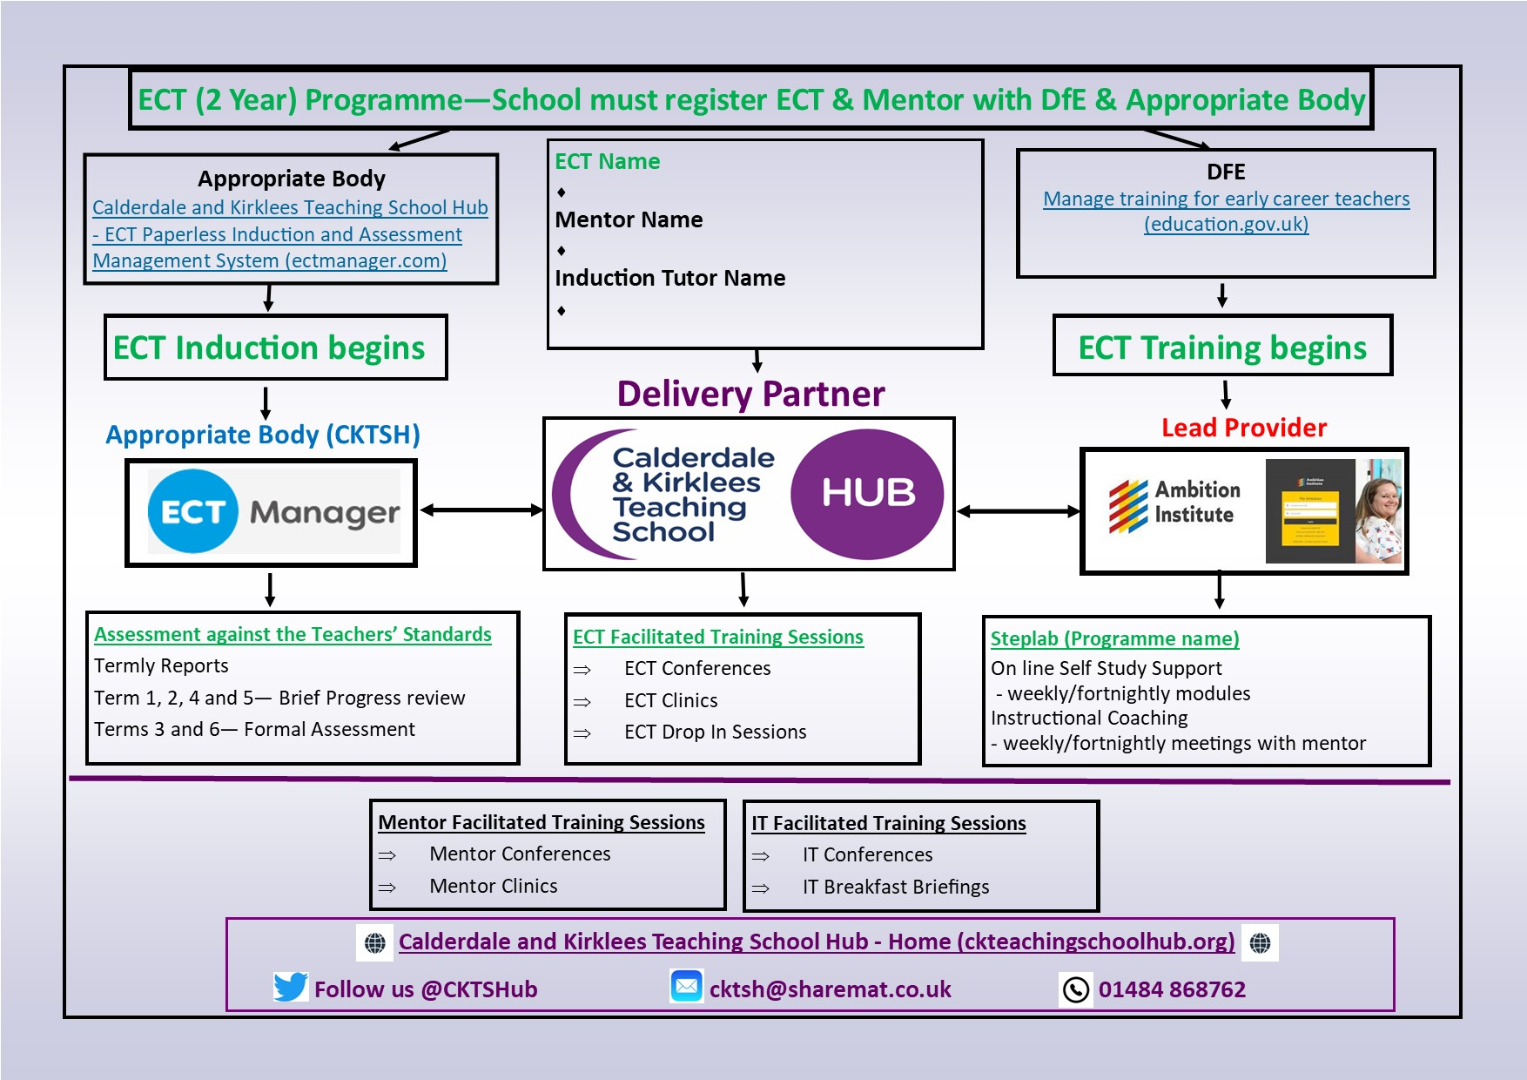
Virtual handbook
Hosted on our website to ensure it is always up to date.
Specific pages for each role involved in ECT induction.
Calderdale and Kirklees Teaching School Hub - ECF Virtual Handbook (ckteachingschoolhub.org)

Slide 15
Appropriate Body charging
Cost per ECT is £250 for a year of induction, charged in the first term. (No increase this year). This is agreed to upon ECT Manager registration.
Reduction of £50 per term not completed (e.g. ECT joins in September but leaves at Easter – 1 term £50 reduction due).
Schools should contact the Hub to claim their reduction – this will not be processed automatically.
Invoices come from C&KTSHub.
An email to be shared with your finance/office manager will be sent out today with resources from this briefing.

Slide 16
AB Quality Assurance and Support visits
Online visits will be arranged to all schools new to the Hub and new induction tutors this term to provide support.
Schools can request a support visit from the Hub at any time – just get in touch.
A variety of user guides, resources and self-study slides are available in the Resources section of ECT Manager
Appropriate Body Quality Assurance visits will also take place this year. We aim to QA all schools with ECTs within a four-year cycle.

Slide 17

Date of next briefing
Thursday 6th November at 7:45am
Meeting link will be shared on our website: Calderdale and Kirklees Teaching School Hub - Upcoming Events
Time for questions.

