Slide 1



ECT Induction Tutors'
Breakfast Briefing
Thursday 6th November 2025
Dionne Heaven
cktsh@sharemat.co.uk

Slide 2
ECF events last half term
21 face-to-face Conferences
368 ECTs and 114 Mentors = 482 participants!
Thank you for all your support in coordinating these in school.
ECT Year 1s Conference 1- 98%
ECT Year 2s Conference 3 – 94%

Slide 3
ECT events this half term
ECT Clinic 1 – choice of dates and start times.
ECT Clinic 4 – choice of dates and times
ECT Conference 1 additional date – 12th November
ECT Conference 3 additional date - 14th November
ECTs have been contacted directly to book on.
Please email the hub if you believe you have an ECT who needs to attend.
ECT Clinic 1 Dates - 2025 – Fill in form
ECT Clinic 4 Dates - 2025 – Fill in form

Slide 4
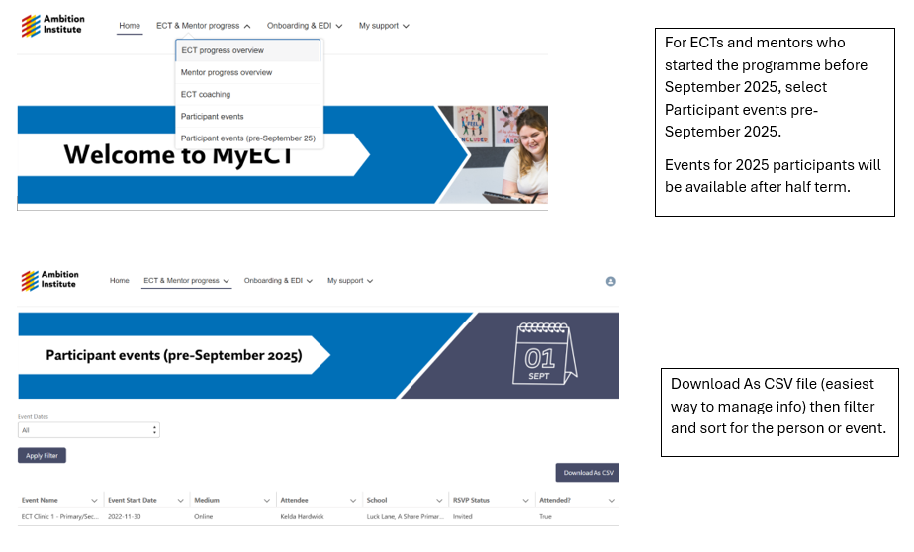
How to check ECTP event attendance

Slide 5
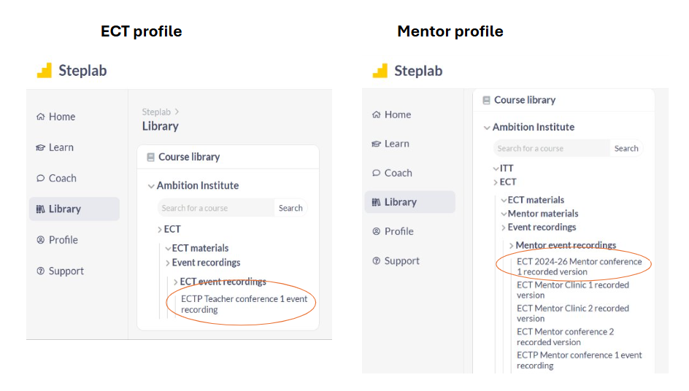
How to access or revisit training materials

Slide 6
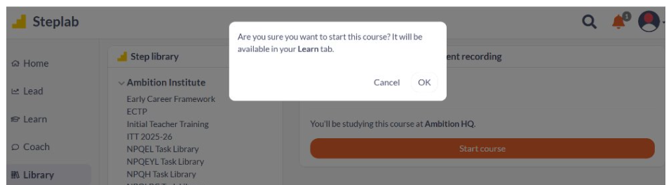
How to access or revisit training materials
ECTs and mentors who have missed events can access the materials here for self-study.
Materials are also available in advance of face-to-face training, which may support some participants with accessing the course more productively.
Materials are available throughout the training period and can be revisited at any point.

Slide 7
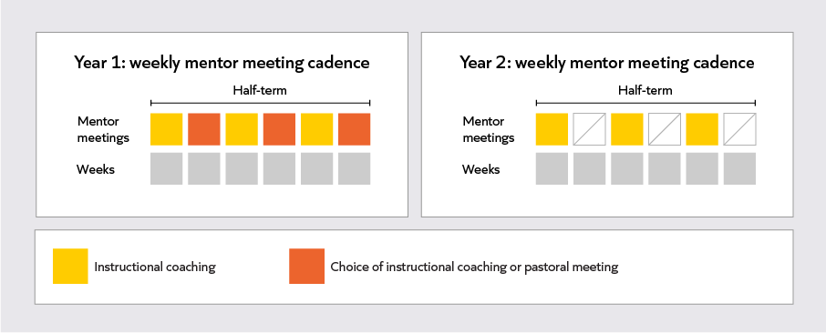
Mentor meetings
Key message - Year 1 mentors should conduct weekly instructional coaching, unless there is a good reason not to.
Notes:
Time: 3 minutes [29]
Purpose: To outline the role and focus of mentor meetings.
Suggested Script:
In year 1, ECTs and mentors meet weekly. They meet fortnightly in year 2.
Instructional coaching is the cornerstone of the mentor meeting – it is a form of coaching which helps ECTs to put their knowledge into practice in a carefully structured and scaffolded way. We will explore instructional coaching in greater depth later in this conference.
Instructional coaching should be run at least fortnightly across both years, to align with ECTs’ fortnightly self-study.
In year 1, there is some flexibility in the coaching a mentor runs in alternate weeks.
Mentors can run additional instructional coaching in these alternate weeks.
Otherwise, mentors can run pastoral coaching.
The choice between instructional and pastoral coaching may be decided by the delivery partner and communicated within their network.
Alternatively, this might be a decision that delivery partners want mentors to make, depending on the needs of their ECT.
If this is the case, mentors can choose between instructional or pastoral coaching in alternate weeks; there is no expectation for them to choose one option or another for the entirety of the year.
To support mentors with this choice, it is important to consider these different models of coaching and their aims:
A pastoral coaching session can provide an opportunity for mentors to check in with their ECT and support them with the broader responsibilities and challenges of being a teacher.
An additional instructional coaching session can provide an opportunity for mentors to support an ECT who has not yet met their previous step, to set a new step or to make the practice of a previously met step more challenging.
Lead in: Let’s briefly zoom in on each of these types of coaching. We’ll start with instructional coaching.

Slide 8
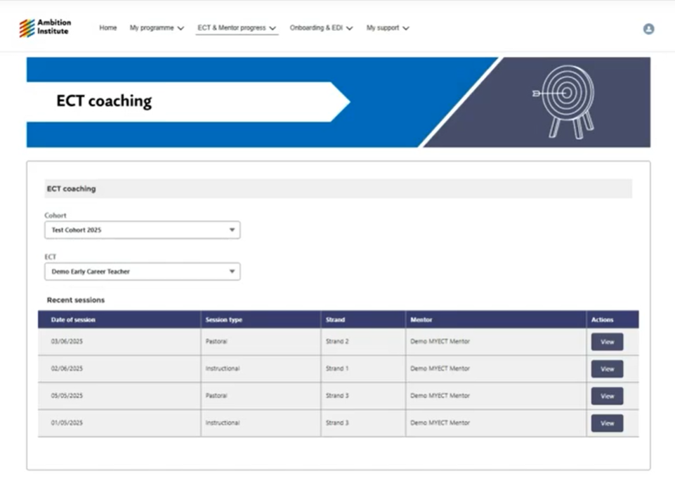
How to monitor coaching on MyECT
Please check for weekly coaching (majority should be instructional).
Click on Actions/View to see the focus of the coaching session.
Year 2 coaching engagement will still need to be monitored through Steplab.

Slide 9
Fully trained mentors
Mentors who have attended all conferences and clinics are classed as fully trained.
Please ask mentors to complete this short Form and they will be sent confirmation and a certificate: https://forms.office.com/e/MBfjEKqZS8

Slide 10
Coaching for Mentors 2025/6
All mentors should receive one CfM visit per year.
Record CfM here: https://forms.office.com/e/3p5GW9jReF
These can be completed by the IT, by the Hub or jointly.
You can set coaches a development step to support their role.
We will select schools to visit, but welcome invitations from you for joint sessions.
Please contact the Hub office if you would like a member of our team to visit you or conduct the meeting with you.

Slide 11
ECT Reports for this term
Friday 5th December - Deadline for submitting progress reviews and assessments on ECT Manager
Please ensure you include examples of classroom practice and evidence from a range of sources in your reports.
Examples comments for progress reviews and assessments can be found in the Resources section of ECT Manager.
Writing Progress Reviews – online training sessions 18th and 26th November 3.45 – 4.30
Meeting links on follow up email and in Calendar on our website Calderdale and Kirklees Teaching School Hub - Upcoming Events

Slide 12

Date of next briefing
Thursday 8th January at 7:45am
Meeting link on our website : Calderdale and Kirklees Teaching School Hub - Upcoming Events (ckteachingschoolhub.org)

