Slide 1



ECT Induction Tutor
Breakfast Briefing
Thursday 8th January 2026
Dionne Heaven
cktsh@sharemat.co.uk

Slide 2
ECT and Mentor events this half term
ECT Conference 2 – choice of dates and venues.
Booking on Eventbrite. All ECTs have had the link.
Mentor Conference 2
(Adapting the coaching model to ECT expertise) - online session; choice of dates and times will be made available to mentors soon. The sessions will run for a maximum of 2 and a half hours. Five sessions have been scheduled to run from the beginning of February – 3 before half term and 2 after.
ECT Clinic 2 and Clinic 5 – will be held in February and March (may begin before half term). Details will be sent to ECTs shortly.

Slide 3
New Jan 2025 ECTs and Mentors
ECT Conference 1 and Clinic 1 – Tuesday 27th January 2026 at Heaton Avenue Primary School, Cleckheaton.
ECTs will be invited directly, based on registration information by the end of this week.
If your ECT has not been invited by 16th January, please contact Jane at the Hub.
Mentor Conference 1 – Friday 23rd January 2026 at Heaton Avene Primary School, Cleckheaton. This is for brand new mentors only.
Booking on Eventbrite – link below
https://www.eventbrite.co.uk/e/mentor-conference-1-friday-23rd-january-2026-registration-1978562341224?aff=oddtdtcreator

Slide 4
ECT and mentor registration/changes
Register any new ECTs or mentors
Sign in to the DfE service to report if an ECT or mentor will begin their induction or ECTP training in the spring term.
Also register any ECTs starting on ECT Manager
Report if something has changed for an ECT or mentor
Sign in to the DfE service to report if an ECT or mentor is transferring to your school, or moving to another school,
part-way through their induction or ECTP based training, or has changed their name or email address
Tell your provider (the Hub) if ECTs or mentors stop training
Contact your training provider directly to report that an ECT or mentor has left teaching, is taking a break, or has taken
a teaching job outside of England (for ECTs, you must report this to their appropriate body too), or to reinstate an
ECT or mentor who was previously withdrawn from training.

Slide 5

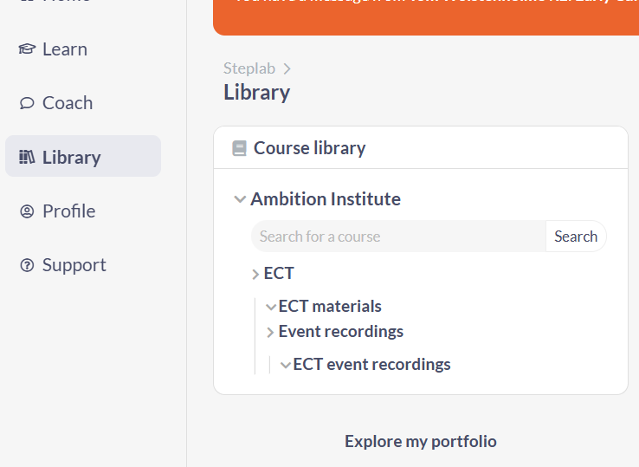
Clinic engagement
Lots of fantastic engagement from ECTs in Clinics 1 and 4 this term.
Issues with school computers blocking cameras and microphones. Please encourage ECTs to check this before they join their clinic.
ECTs can access Event Recordings in the Library on Steplab in advance of clinics. They can also access after the clinics if they miss them or want to revisit.

Slide 6

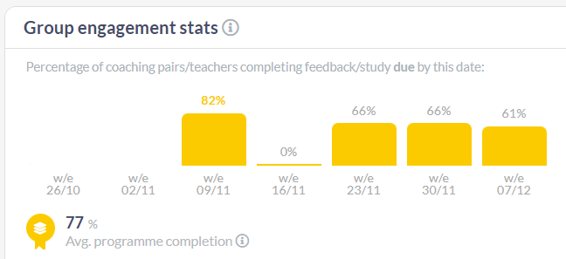
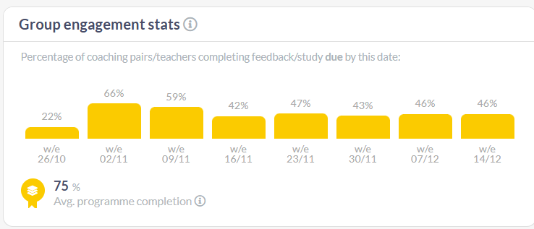
Steplab engagement
Year 1
Year 2
Engagement has ranged been between 40 – 80% last half term – thank you for your support.
Reminder of expectations
Year 1 ECTs – fortnightly self-study and weekly mentoring (instructional on Steplab; pastoral on MyECT)
Year 2 ECTs – fortnightly Stretch modules and/or revisiting Year 1 modules as identified by Diagnostic Tool or individual need and fortnightly coaching on Steplab.
Induction Tutors can change their term dates if Easter or Spring Bank holidays differ from Hub dates.

Slide 7
Coaching for Mentors 2026
All mentors should receive one CfM visit per year.
Record CfM here: Coaching for Mentors Form 2025/2026 – Fill in form
These can be completed by the IT, by the Hub or jointly.
We will select some schools to visit, but welcome invitations from you for joint sessions. Please contact Jane to arrange.

Slide 8
AB feedback from ECT reports
Only around 5% rejected this term – thank you for your efforts to maintain such high quality.
Main reasons for rejection are insufficient detail - no reference to Teachers’ Standards or examples of classroom practice. Some reports based on a single lesson observation.
Examples shared for training purposes are anonymised – please include your ECT’s name and any pertinent personal information.
More reference to evidence sources and the ECTs’ impact in the classroom would be even better.

Slide 9

Date of next briefing
Thursday 26th February at 7:45am
Meeting link on our website : Calderdale and Kirklees Teaching School Hub - Upcoming Events (ckteachingschoolhub.org)

