Slide 1



ECT Induction Tutor
Breakfast Briefing
Thursday 16th April 2026
Dionne Heaven
cktsh@sharemat.co.uk

Slide 2
ECF Events this half term
ECT Clinic 3 – half term 6 dates
ECT Clinic 6 – half term 6 dates
Booking links will be sent out to ECTs soon
Mentor Clinic – May and June dates. - Booking link will be shared soon
Any new mentors requiring Conference 1 and/or Conference 2 can access Event Recordings in their Steplab library at any time.
January 2025 starters: ECT Conference 2 - Tuesday 28th April, Upper Batley High School (Trust Development Centre)

Slide 3
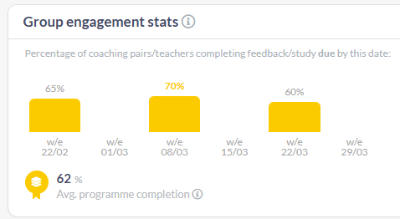
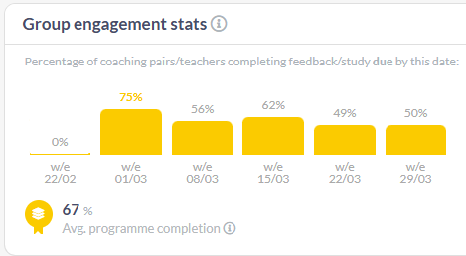
Steplab Engagement
2024 cohort
2025 cohort
Average programme completion indicates the average proportion of available study modules that teachers in this group have completed.

Slide 4
Mentor Grant funding from DfE - update

Slide 5
Mentor Funding from DfE – see attached document
The grant is paid based on:
20% for evidence that the mentor has started the programme.
80% for evidence that the mentor has completed the programme, which requires meeting the 75% engagement criterion.
If a mentor does not meet the 75% engagement requirement, the school will not be eligible to receive 80% of the grant payment. This ensures that public funding is allocated fairly and in line with actual participation in the training. If an early career teacher leaves their programme for any reason, or has any period of leave, their mentor can still continue training, and the school would receive payment, provided they engage.

Slide 6
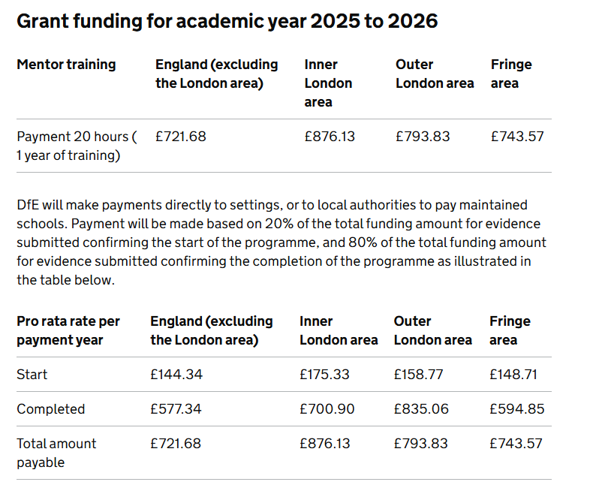

Slide 7
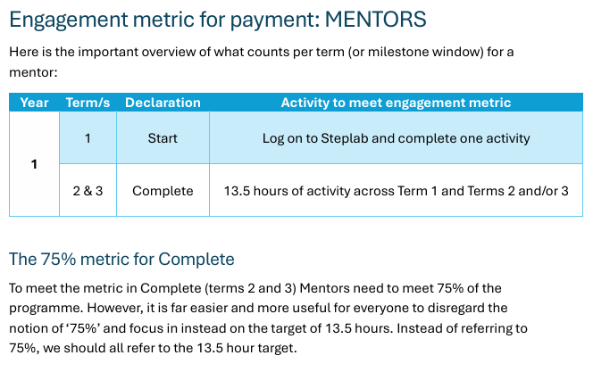
Mentor Engagement 75% = 13.5 hours

Slide 8
How a mentor can reach the minimum 13.5 hours over Year 1
Description | How | Number of Mins/hours
Mentor Conference 1 | Attend hub event or complete event recording on Steplab | 5.5 hours
Mentor Conference 2 | Attend hub event or complete event recording on Steplab | 5.5 hours
Mentor Clinic | Attend hub event or complete event recording on Steplab | 1.5 hours
Orientation Module | On Steplab | 40 minutes
Weekly Coaching | 1 Observation & 1 Feedback recorded on Steplab or Pastoral Coaching logged on MyECT | 15 minutes
Mentor Self-Study Modules | On Steplab | 40 minutes per module
Coaching for Mentors | Induction Tutor observes coaching session and logs on hub Form | 1 hour

Slide 9
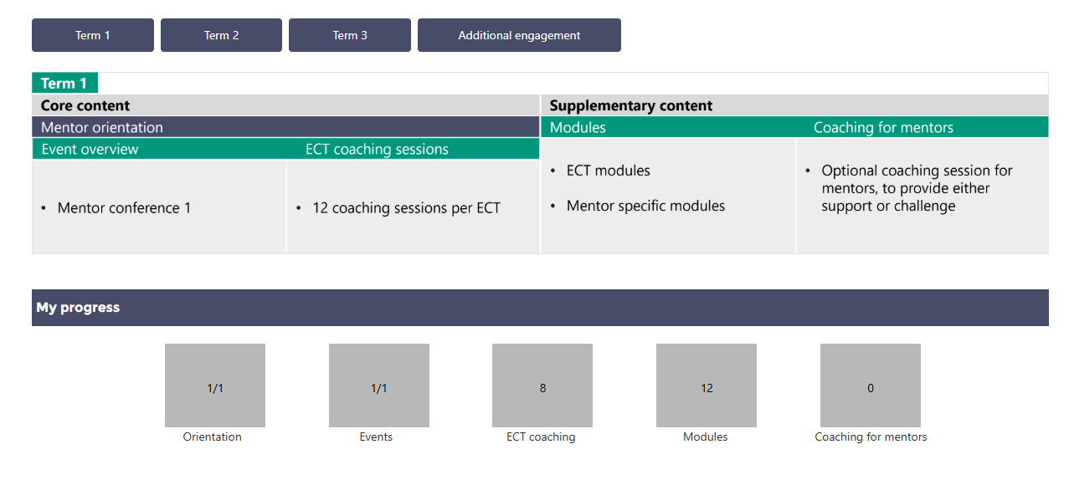
How Mentor Progress looks on MyECT Term 1 (Example)
Term 1 – As seen below
Orientation – 40 mins
Conference 1 – 5.5 hours
8 coaching – 2 hours
12 modules – 6 hours
Term 1 total 14.2 hours

Slide 10
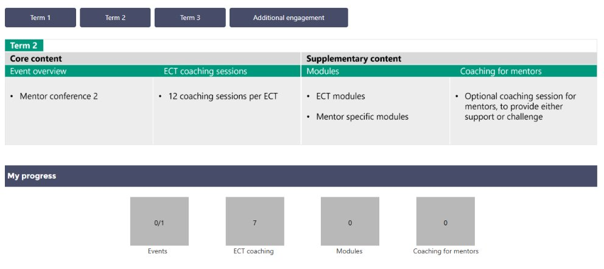
How Mentor Progress looks on MyECT Term 2 (Example)
Term 2 – As seen below
7 coaching – 1.75 hours​
Term 1 – 14.2 hours
Term 2 – 1.75 hours
TOTAL = 15.95 hours

Slide 11
Mentor churn – CKTSHub context
AY 25/26 so far - ECTs starting ECTP - 201
Mentors starting ECTP - 141
AY 24/25 - ECTs starting ECF training - 244
Mentors starting ECF training - 302
AY 23/24 - ECTs starting ECF training - 229
Mentors starting ECF training - 210

Slide 12

Coaching for Mentors 2025
All mentors should receive one CfM visit per year.
Record CfM here: Coaching for Mentors Form 2025/2026 – Fill in form
The Hub team can support you with CfM visits this term. Please contact us at the Hub and we can arrange a suitable date with you.

Slide 13
Progress Reviews and Assessments
Spring term assessments and Progress Reviews were of good quality and most were submitted before the deadline - thank you!
Please ensure you make links to some of the Teachers’ Standards and state the evidence you have based your judgements upon.
Consider the impact your ECT has had on learning in their classroom, not just a narrative of their actions.
Summer term submission deadline – Friday 3rd July
Please allow time for headteachers/principals to read and add their signatures to assessments.

Slide 14
ECT Registration from September '26
The DfE are introducing a new registration portal (yes, again!) in September – RECT.
We will share further details about this at the June breakfast briefing.
Please do not attempt to register any September '26 starters until you have received information from us to say the portal is live.

Slide 15
Save the Date - Induction Tutor Conference
Wednesday 8th July
10.30 - 2.30 at Venue TBC
Agenda will include:
New DfE portal
Using MyECT and Steplab effectively
Moderation of assessments
Refresher training/new IT training
Sharing good practice & networking
Booking link will be shared after this meeting.

Slide 16

Date of next briefing
Thursday 4th June at 7:45am
Meeting link on our website : Calderdale and Kirklees Teaching School Hub - Upcoming Events (ckteachingschoolhub.org)

