Slide 1



ECT Induction Tutors
Breakfast Briefing
Thursday 3rd September 2026
Dionne Heaven
cktsh@sharemat.co.uk

Slide 2
Welcome back!
We are looking forward to working with you all this academic year.
New ECT and mentor registrations
Data accuracy – a plea
Training events for ECTs and mentors
My ECT and Steplab access
Coaching and engagement requirements
Tutor training and resources
Appropriate Body update
New for this term - Website link for all Autumn term events
Calderdale and Kirklees Teaching School Hub - 2026 Autumn term events for ECTs and Mentors

Slide 3
New ECTs and Mentors for 2026
Two steps to add a new ECT:
Register your ECTs and mentors on the DfE portal: Register early career teachers - Register early career teachers - GOV.UK
For further guidance on using the RECT portal, please refer to our website:
Calderdale and Kirklees Teaching School Hub - Registering ECTs & Mentors for training and induction
2. Register your ECTs on ECT Manager: Calderdale and Kirklees Teaching School Hub - ECT Paperless Induction and Assessment Management System (ectmanager.com)
Please use the same email address to register ECTs on both portals. You can update these to a school email address if you have already registered with a personal one.
We are working to identify any ECTs who are only registered on one website. We will contact individual schools to advise.
Mentors only need registering on RECT and must be paired with their ECT there.

Slide 4
Data accuracy – a plea
September is a busy and exciting time with lots of newness and change.
Please can you and all ECTP participants check that the data we have for them is accurate:
  Correct email address entered on Eventbrite when booking a conference
  Correct and matching email address on DfE portal and ECT Manager
  Correct ECT and mentor pairing on DfE portal and ECT Manager (esp. for Year 2)
  Correct head teacher information on ECT Manager
  Correct levels of access on ECT Manager (Tutor, Induction Lead or Head)

Slide 5
ECT Conferences
Conference 1 for Year 1 ECTs and Conference 3 for Year 2 ECTs
Primary, Secondary and Special contexts
Choice of dates and venues (first come, first served)
Booking via Eventbrite. Links will be shared again this morning.
Please talk ECTs through how to request cover and check school calendar
We will Bcc Induction Tutors into correspondence with ECTs regarding event attendance so that you aware of chosen dates for cover purposes, etc.

Slide 6
ECTP Mentor training (new Sept 2026)
Conference 1
Friday 18th September - Heaton Ave Primary School, Cleckheaton
Wednesday 23rd September – The Maltings, Halifax
Friday 25th September – Batley Girls' High School
Booking link will be shared again on the follow up handout, as well as with mentors we are already aware of. Please share with all new mentors in your school.
Mentors have one year to complete their training. This comprises two face-to-face conferences and one online clinic. Conference 2 – spring term. Clinic – summer term.

Slide 7

MyECT and Steplab
Ambition platform – login here to complete onboarding and access Steplab – Login
There are useful video guides in the Support section
Complete Steplab Access Form here
Log in to Steplab here
Support and resources here

Slide 8
ECT Engagement requirements
ECTs should complete their Steplab Access Form on My ECT and then log in to Steplab.
If they have not received a SLAF email, please contact us at the hub.
ECTs can complete their orientation modules prior to attending their Conference 1 event.
NO requirement to complete any Theme 1 modules until after attending Conference 1.
Self-study modules to then be completed once every fortnight throughout the two years of induction. No blocks of study please.

Slide 9
ECT Coaching requirements
September ‘26 new starters
MUST have WEEKLY coaching (instructional recorded on Steplab, pastoral recorded on MyECT)
MUST have at least fortnightly instructional coaching.
Fortnightly reading – one module at a time.
Theme 1 – autumn term; theme 2 – spring term; theme 3 – summer term
Year 2 ECTs
Fortnightly coaching on Steplab and fortnightly reading modules
Theme 4 – autumn term; theme 5 – spring term; theme 6 – summer term

Slide 10
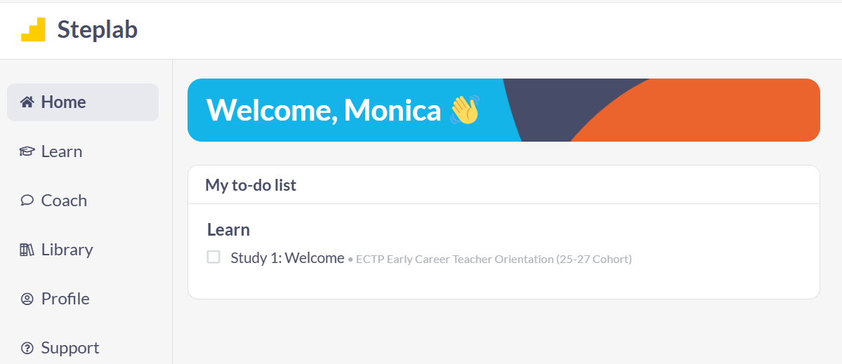
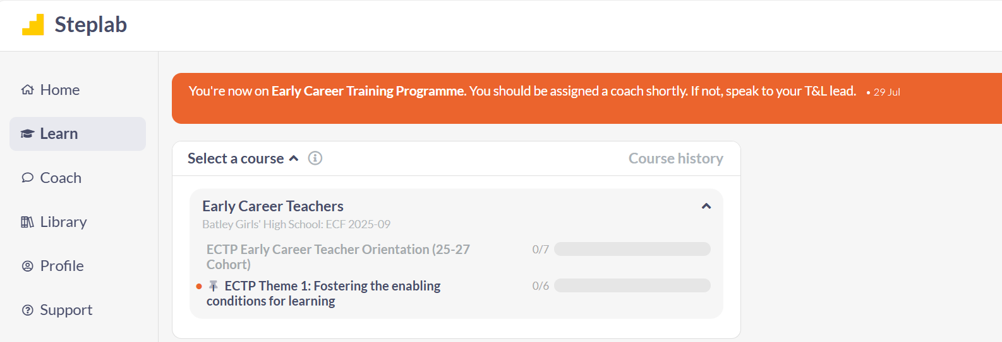
ECT Welcome module
ECTs can complete the Welcome module – Orientation.
No requirement to begin the Theme 1 reading until they have been to the Conference 1 event.
Please remind them – only one module each fortnight. They can re-read it if they wish to.

Slide 11
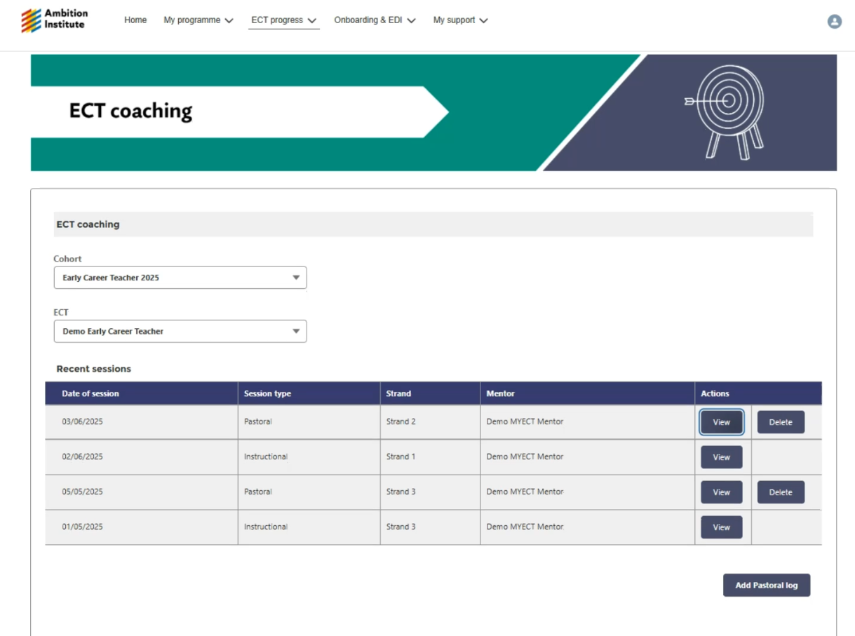
Record pastoral coaching here

Slide 12
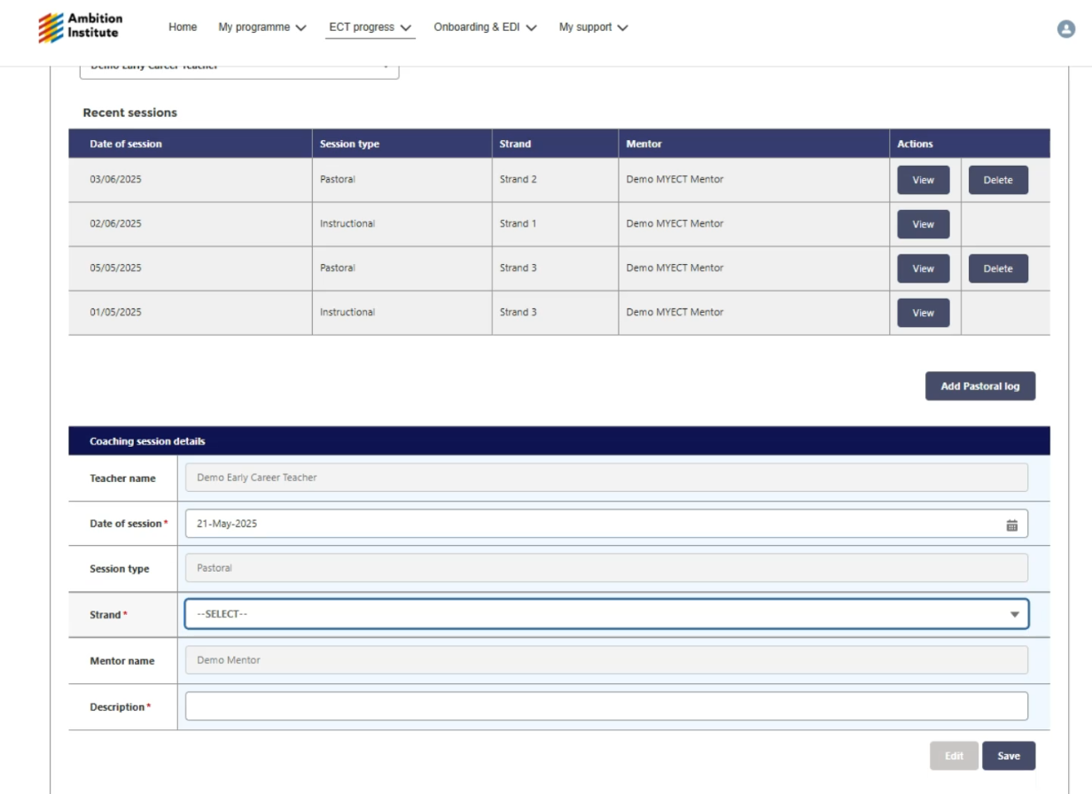
The mentor must complete a brief log of the pastoral coaching session, otherwise it will be classed as non-engagement.

Slide 13
Steplab access and onboarding
Please ensure all staff complete the onboarding process – Steplab Access Form on MyECT
Check your To Do list on Steplab to ensure your ECTs and mentors have been paired together correctly. If not, check DfE portal for matches.
Let us know if anyone has not received their onboarding email or cannot access My Ambition.
Email contact@ambition.org.uk for all registration and onboarding queries or password resets.

Slide 14
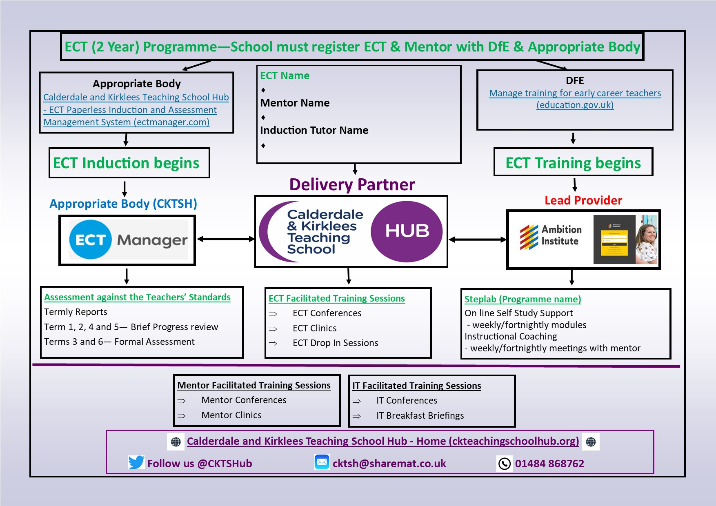
Virtual handbook
Hosted on our website to ensure it is always up to date.
Specific pages for each role involved in ECT induction.
Calderdale and Kirklees Teaching School Hub - ECF Virtual Handbook (ckteachingschoolhub.org)

Slide 15
Appropriate Body charging
Cost per ECT is £275 for a year of induction, charged in the first term. This is agreed to upon ECT Manager registration.
Reduction of £60 per term not completed (e.g. ECT joins in September but leaves at Easter – 1 term £60 reduction can be claimed).
Schools should contact the Hub to claim their reduction – this will not be processed automatically.
Thank you for providing details of your school's finance contact to aid in invoicing.

Slide 16
AB Quality Assurance and Support visits
Online visits will be arranged to all schools new to the Hub and new induction tutors this term to provide support.
Schools can request a support visit from the Hub at any time – just get in touch.
A variety of user guides, resources and self-study slides are available in the Resources section of ECT Manager
Appropriate Body Quality Assurance visits will also take place this year. We aim to QA all schools with ECTs within a four-year cycle.

Slide 17

Date of next briefing
Thursday 5th November at 7:45am (Remember, Remember!)
Meeting link will be shared on our website: Calderdale and Kirklees Teaching School Hub - Upcoming Events
Time for questions

